Slide 1
Quiz Website
Jatin Maurya
Henil davariya
Falguni solanki

Slide 2
The Problem
Introduction
Elephanta Quiz
Uses
Features
Create, edit, modify and dashboard
Technology used
Html, CSS, JS, Node.js, Express Js, Mongo DB
You can create quiz

Slide 3


Slide 4
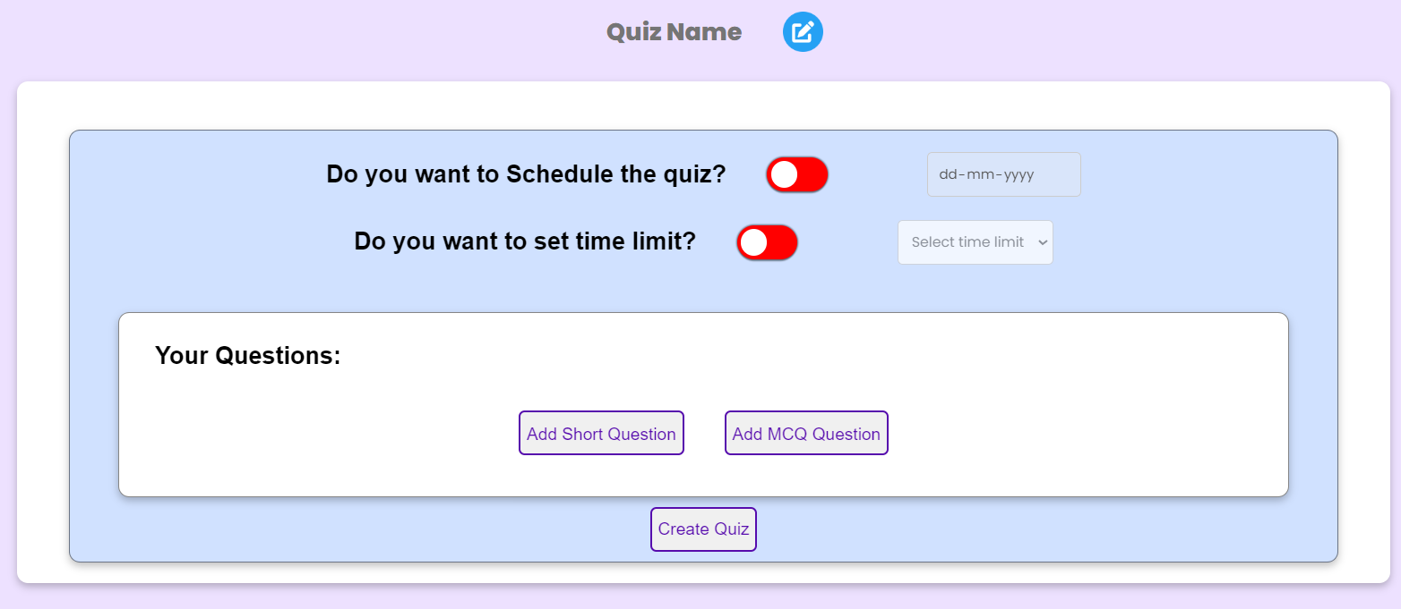
Create Quiz Page
Here you can create quiz dynamically and there are many other options like to schedule quiz, set time limit and to add short and mcq types questions.

Slide 5
Highlights
Developed a feature-rich quiz website allowing users to create, schedule, and manage quizzes with real-time tracking and validation.
Implemented advanced functionalities such as time limits per question, read-only mode for created quizzes, and an automatic profile update feature.
Integrated a robust customer support page with validation to ensure the submission of only valid queries.

Slide 6
Features
Create Quiz
Check the quiz created
Check the time and date of creation
Check the number of quiz you have created
Delete the created quiz
You can ad short and MCQ questions in the form

Slide 7
Tech - Stack
HTML
CSS
Js
Mongo DB
Node.Js
Express Js

Slide 8
Thank You

